Slide 1
Challenging Conversations in Family and Group Conferencing for Adults
Facilitators

Slide 2
Embracing Difficult Conversations
When we consider challenging conversations within the context of an FGC there are three perspectives we need to take
  The person at the centre of the Family Group Conference
  The network
  The professional supporting the FGC process
These slides will provide an overview of what a difficult conversation may be like for each of these perspectives, with some ideas for how to work with issues that may arise.
Notes:
A fear when preparing for, and supporting, an FGC can be the possibility of difficult, emotive conversations.
The way to combat this is to consider the perspectives of those involved and to develop strategies to manage difficult conversations that may arise.

Slide 3
What is a challenging conversation?
Before we look at individual perspectives, it is worth exploring some general aspects of conversations that take place within the context of FGC.
First, what do we mean by a conversation?
‘An oral exchange of sentiments, observations, opinions or ideas’ (Merriam-Webster definition)
Mutuality – a two-way process
Active engagement from both parties
Courage needed by all participants for meaningful dialogue & positive outcomes
How often do you focus on the courage others need to have a meaningful conversation?
Notes:
Conversation is an integral part of an FGC. But this can often be difficult due to previous conflicts, issues with communications styles and high emotions.
The Merriam-Webster definition of a conversation is: An oral exchange of sentiments, observations, opinions or ideas.
Central to this definition is mutuality: a conversation requires the active engagement of all participants. Meaningful and authentic dialogue as part of this is dialogue that can lead to positive change. But conversations like this rely on both parties expressing their position effectively and being open to negotiating the outcomes of discussion.
This is an important starting point for thinking about conversations in challenging circumstances, especially in a professional context where the presence of power needs to be acknowledged and attended to.
Within the context of an FGC, the conversation needs to come from the person at the centre of the network and network members. This can feel unusual to practitioners, who may be more used to conversations with those accessing services in which they are often the driving force. But the supporting role of the practitioner is still important in the FGC context, as we can provide support and guidance in the lead up to, and during the meeting, to support productive conversations.

Slide 4

Conversations and emotion
Emotions are present for all of those involved in an FGC.
We’ll spend some time now thinking about the relationship between challenging conversations and emotion.
Emotions will be present for the practitioner and the person using the service, as well as their network members.
It can be difficult to manage a range of people’s emotions, particularly if these become heightened. But it is important for practitioners to remember that they are there to support the FGC process, and that the adults involved are autonomous and able to manage their emotional responses.
Notes:
If we return to the three perspectives involved:
For the person at the centre of the FGC there may be a lot of conflicting emotions. Part of preparing them for the FGC is understanding these emotions. This can be a rewarding activity but can also take a toll on both the person and the practitioner. Practitioners need to be aware of this to be able to build in strategies to minimise negative effects for themselves and to provide guidance for similar strategies for the referred person.
People involved in the network will also experience a range of emotions. These individuals may not have their own support outside of this process. It is important for the practitioner to remain within their professional boundaries to avoid taking on responsibilities that are beyond their remit.
- Practitioners are also human beings with their own emotions. You will be used to managing your emotions as part of other aspects of your role, but if you are unused to FGC then it may be that you experience some emotion around the topic. Key here is honesty and accountability, being honest about your feelings about the process, and taking accountability for these emotions. You can do this by seeking support from colleagues, your line manager, as part of supervision or however you usually seek support in your role.
The key learning here is the importance of emotional awareness – being aware of the way that emotions are playing out in a situation in yourself and in the mind of the other person. Coming face to face with difficult and powerful emotions, even when not named, will impact on us, and can research shows that they can monopolise brain activity – we’ll explore further on about understanding more about what might be happening in our brain when faced with highly emotional situations, but also what might be going on in the brain of the other person that may impact on engagement.

Slide 5
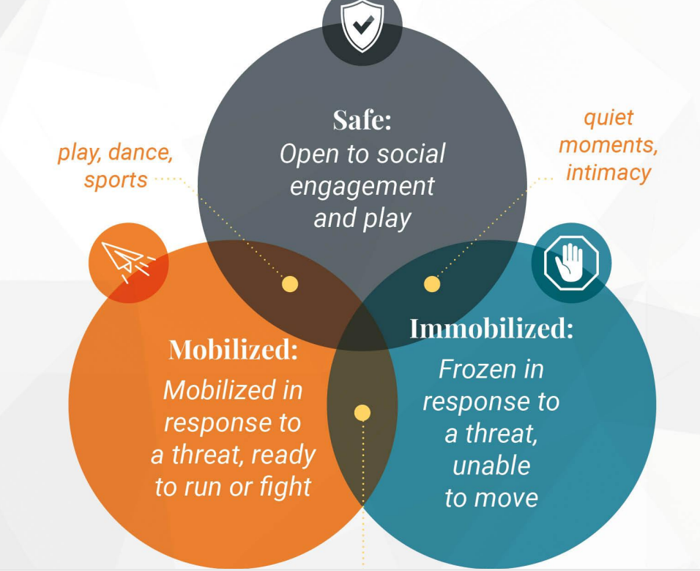
Conversations and the brain
Steven Porges – Polyvagal theory (What is Polyvagal Theory | Polyvagal Institute, n.d.)
(Porges, 2022)
Notes:
It’s helpful to think about what happens to us, our bodies and our brains, when we are experiencing heightened emotions in difficult conversations. A theory has been put forward by Steven Proges, called the poyvagal thery, that looks at the interplay between the nervous system, our brain and our responses to the environment we are in, particularly responses to threat which can include emotional threat.
This shows three states that our bodies and brains can be in.
Social engagement (safe) where we’d like to be - open and engaged, able to listen, be curious, take on new information. Best place for us and the other person (or persons) when we’re having a conversation that’s challenging.
Stressed (mobilised) - sympathetic nervous system is triggered - we can tell in our bodies some signs that we are beginning to feel stressed – such as heart rate increasing. It’s often responses to difficult emotions, even unconscious emotions, that can trigger a stress response. And as we continue to become more stressed our fight or flight mechanisms are triggered in the brain. When these responses are triggered we’re more likely to feel anxious, overwhelmed and impulsive. Our ability to remain present and engaged in the conversation be comes more difficult.
Immobilised - when we are in deep threat it can trigger a freeze response – shut down or dissociation.
This diagram helps us to be aware of what may be going on for the other person – if they are in the ‘immobilised’ state, what might be behind that?
It’s helpful to be aware of what is going on in our bodies and minds that can help us return to the social engagement state – just being aware can help us do this, as well as something as simple as deep breathing that can help regulate our nervous system.
Important to note criticism for this theory highlights other systems must also be considered that interact with Vagus nerve is understanding our biopsychological wellbeing including: immune, endocrine and gastrointestinal systems. We would encourage practitioners to research this area further.

Slide 6

Reactions to being faced with challenging circumstances
Common first reactions…
  Avoidance: desire to avoid directly confronting the issue at hand.
  Delay: postponing tackling the issue, potentially for as long as possible.
  Delegation: can be driven by ”a desire to avoid feeling responsible or being blamed” (Steffel et al., 2016)
(Meyer et al, 2009)
Notes:
All three perspectives involved with an FGC can experience these negative reactions.
Engaging in conversations can be challenging when there are high levels of hostility and low levels of trust. Both hostility and issues with trust can be present in relationships that have added complexities.
For people accessing services, these reactions may present in several ways such as non-engagement or missed appointments or reluctance to continue the FGC process.
Similar behaviour may be present among the network, including missed appointments or reluctance to be part of the process.
One strategy to move past this is practising ‘respectful uncertainty’ (Laming, 2003) whereby practitioners aim for a balance between trust and doubt. For practitioners, the ability to demonstrate respect while discussing sensitive issues, and potentially enforcing the law, is key.
When faced with challenging conversations, some people may find their first reaction is to sidestep the difficulty.
When considering practitioners, it is important to note that even in situations that require high levels of professionalism, human beings are naturally inclined to employ a range of techniques to avoid conflict. A typical response to dealing with situations presenting conflict or distress may be to ‘delay, avoid or delegate’ (Meyer et al., 2009, p. 352). For all involved, this may look like delaying the FGC, or meeting with relevant parties for FGC planning to postpone a potentially challenging situation.
Delegation is where people delegate choices, especially choices with potentially negative consequences. This is driven by a desire to avoid feeling responsible or being blamed for such decisions. For those accessing services and their network this may look like passing responsibility as part of the FGC onto others. Those accessing services may try to shift this responsibility for practitioners. It is important for practitioners to be clear on their role and responsibilities in the FGC process to ensure that they do not take on the responsibilities of others in the process.
Reflective question: Can you think of a situation where you engaged in one or more of these reactions? What did you do to manage this?

Slide 7
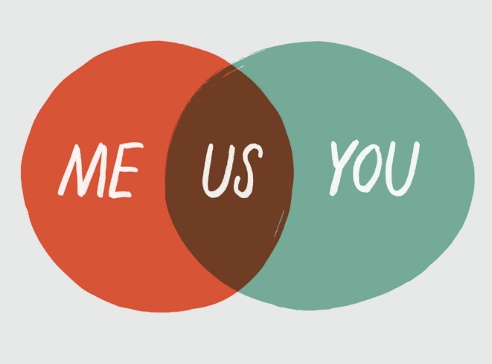
Using tools to support planning conversations
Notes:
It might be assumed that approaching conversations in challenging circumstances just involves a practitioner having the confidence and skills to articulate themselves assertively. But this – as we have seen – does not prepare us adequately for the emotional content that may arise as part of discussions about FGC and it can mean that, in practice, the focus of the conversation may be on what needs to be said, rather than the relationship.
Focusing solely on ourselves ignores the central tenet of mutuality in conversation. Any conversation is a two-way process with three aspects that need attention: ‘me’, ‘you’ and ‘us’. These are key aspects of the FGC process, encouraging those involved to see their own experience but also the experience of those around them.
Whilst practitioners are in a supporting role in an FGC, we still need to consider how emotion can impact on the practitioner (‘me’) both negatively and positively in a work situation and the same attention should be paid to how practitioners converse with the person they are supporting (‘you’).
When discussing the FGC with the person you are working with, this model can be a helpful tool for allowing them to see the multiple perspectives involved. It can also help them to see that this is a collaborative process that should build support.

Slide 8
Nonviolent or compassionate communication
Observation
Facts
Feelings
Emotions
Needs
Values
Requests
Actions
Choice
Connection
Freedom
Intention
(Rosenberg, 2015)
Notes:
This is a technique called ‘compassionate’ or ‘nonviolent’ communication that we are going to look at as an example of communication you could use as part of the FGC process. This includes in your direct work with the person at the centre of the FGC but also as a skill they could seek to develop to use in communication with their network. This is also a useful framework to draw on when preparing the network for the FGC, to allow for useful and productive discussion.
‘Compassionate’ or ‘nonviolent’ communication is based on the idea that all human beings have the capacity for compassion, and they only resort to harmful behaviour when they don’t recognise more effective strategies for meeting their needs. Nonviolent communication consists of expressing honestly and receiving empathically through the four components (shown on the slide):
observations (facts – what we observe is happening in a situation)
feelings (emotions – how we feel when we observe what is happening) could also add in here how the other person is feeling
needs (values – what needs of ours are connected to those feelings)
requests (actions – what we want from the other person). (Rosenberg, 2015, p. 6)
As you can see, the elements of compassionate communication require those involved to move away from reacting out of emotion. This can be difficult in highly emotive situations but providing tangible frameworks for the discussion can be helpful, for example asking those in the FGC to consider framing their experiences using these four elements – observing the situation, giving a label to the feelings they are experiencing, considering what their needs are, as well as the needs of the other person/people involved and producing requests.
We should not expect that this is an easy process, or that people will not slip into hostility, or anger, or struggle to frame their experiences using these labels. It may be that this style of communication does not suit the person and their network. But it is one option that practitioners could put forward if those involved in the FGC are receptive to it.

Slide 9
Dialogic Practice: Garavan’s six steps
Purpose: Allowing the individual to identify and define their issue.
Principles: Commit to curiosity, building dialogue, and finding shared understanding.
Goals: Remaining open to agreeing action, goals, and outcomes.
Assumption: The practitioner is not necessarily someone who knows, but someone who learns.
Methodology: After the problem is explored, questions are generated, and dialogue becomes oriented to finding solutions.
Requirements: Meaningful dialogue requires time and commitment. (Garavan, 2013)
Notes:
Another framework that can help structure conversations is Garavan’s six steps.
Many of these steps align with the wider goals and purpose that often underpins FGC.
These steps can form part of early conversations with the referred person, asking them to consider the purpose of an FGC for them, considering what shared understanding, between them and you as a practitioner, and them and their network, could look like. Agreeing a goal can be helpful for developing a plan for the FGC and encouraging continued engagement and motivation. The notion of assumptions is also important here, practitioners should refrain from assuming anything about the referred person, or their network, but instead should be open to learning about them and their dynamics. Methodology may refer to the practical solutions that can arise from an FGC. Understanding about time and commitment is key here, as we will explore in other modules, both factors are essential throughout the FGC process.

Slide 10

Maintaining and encouraging assertiveness
An adaptive style of communication in which individuals express their feelings and needs directly, while maintaining respect for others.
A lack of assertiveness may contribute to depression and anxiety, whereas maladaptive approaches to assertiveness may manifest as aggression.
(APA Dictionary of Psychology, 2018)
Notes:
Assertiveness is expressing your thoughts, emotions, beliefs and opinions in an honest and appropriate way. As assertiveness should be encouraged in others it is also important to remember that we should always respect the thoughts, feelings, opinions and beliefs of other people.
Assertiveness allows individuals to assert their personal rights without undermining the rights of others. Assertiveness is considered a balanced response, being neither passive nor aggressive, with self-confidence playing an important part. An assertive person responds as an equal to others and aims to be open in expressing their wishes, thoughts and feelings.
Within the often complex dynamics of families involved in FGC processes, assertiveness is often a key skills for both the practitioner and the referred person and their network. This ties to the other models discussed in these slides, with the aim of open and honest communication as the goal.

Slide 11
Conclusion
As we have explored, difficult conversations and conflict may arise as part of the FGC process.
We have looked at possible frameworks and models that may be useful for practitioners to draw on when part of an FGC process.
But practitioners can also draw on their existing communication skills to build rapport with the referred person and their network.
Key to success here is understanding the role emotions play in the dynamics of the relationships involved in the FGC and that emotions, even negative ones, are important parts of the process.

Slide 12

References
Manzotti, A., Panisi, C., Pivotto, M., Vinciguerra, F., Benedet, M., Brazzoli, F., Zanni, S., Comassi, A., Caputo, S., Cerritelli, F., & Chiera, M. (2024). An in‐depth analysis of the polyvagal theory in light of current findings in neuroscience and clinical research. Developmental Psychobiology, 66(2),​ https://doi.org/10.1002/dev.22450
Meyer, E. C., Sellers, D. E., Browning, D. M., McGuffie, K., Solomon, M. Z., & Truog, R. D. (2009). Difficult conversations: Improving communication skills and relational abilities in health care. Pediatric Critical Care Medicine, 10(3), 352–359 http://doi.org/10.1097/PCC.0b013e3181a3183a
Porges, S. (n.d.) What is Polyvagal Theory? Polyvagal Institute. https://www.polyvagalinstitute.org/whatispolyvagaltheory ​
Porges, S. (2022). Polyvagal Theory: A Science of Safety. Frontiers in Integrative Neuroscience, 16,​ https://doi.org/10.3389/fnint.2022.871227
Rosenberg, M. B. (2015). Non-violent communication: A language of life (3rd ed.). PuddleDancer Press.
Steffel, M., Williams, E., Perrmann-Graham, J. (2016). Passing the buck: Delegating choices to others to avoid responsibility and blame. Organisational Behaviour and Human Decision Processes, 135, 32-44. https://doi.org/10.1016/j.obhdp.2016.04.006

Slide 13
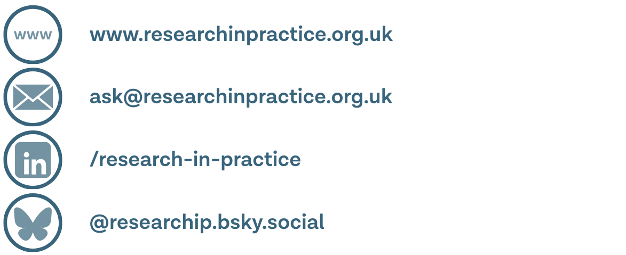
Thank you

